Slide 1

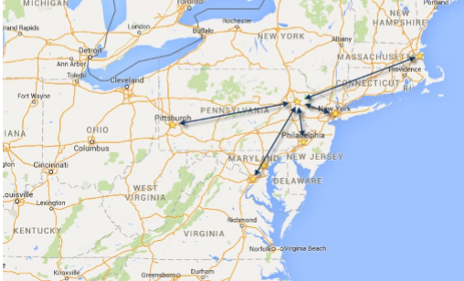

November 11-15, 2019 | Pocono Manor, PA
Great speakers with top content
A fraction of the cost of the more crowded conferences
– 3-day conference plus lodging for less than $1000
Full day deep dive preconference sessions available
Easy to get to from almost anywhere
In addition to the breakout sessions you get a great hallway
track, attendee reception, game night and more
Full day of kids & family sessions on Friday, free for families of attendees
Discounted Kalahari Waterpark room nights: stay, learn and play all in one place
– https://book.passkey.com/e/49827239 or call 877-525-2427 and mention Techbash
Save on conference admission by using code DEVCOMMUNITY40
https://techbash.com or @techbash

